Slide 1
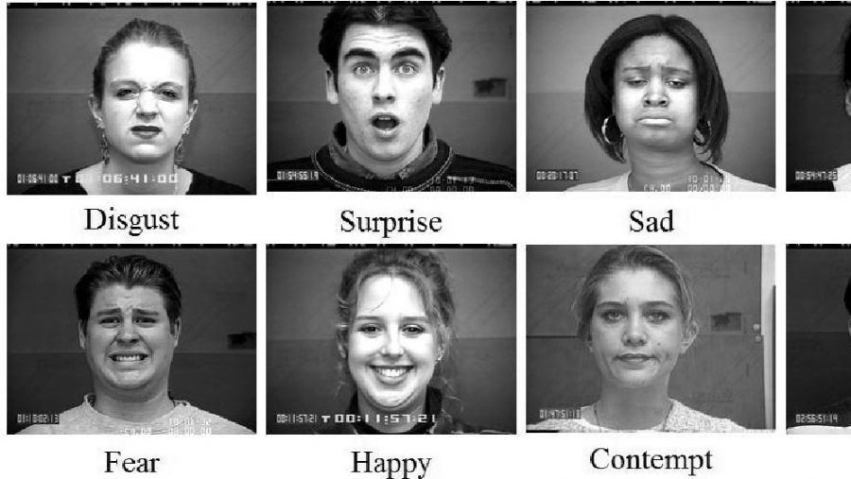
Facial Expression Recognition using Machine Learning

Slide 2
TEAM MEBERS
Tarun Kumar Punna (100801175)
Srihitha Pasupuleti (100805018)
Mohit Mendi (100800234)
Aditya Patel (100800011)

Slide 3
SUMMARY
Personality, attractiveness, age, and gender can be also seen from someone is face. Thus, the face is a multi-signal sender/receiver capable of tremendous flexibility and specificity.
In turn, automating the analysis of facial signals would be highly beneficial for fields as diverse as security, behavioral science, medicine, communication, education, and human-machine interaction.
The goal is to build an Application to detect facial emotions accurately

Slide 4

DATASET
In order to train our model, we are inputting the data which is divided into different folders .we are taking the size of images as 48*48 and the number of classes as 7.

Slide 5
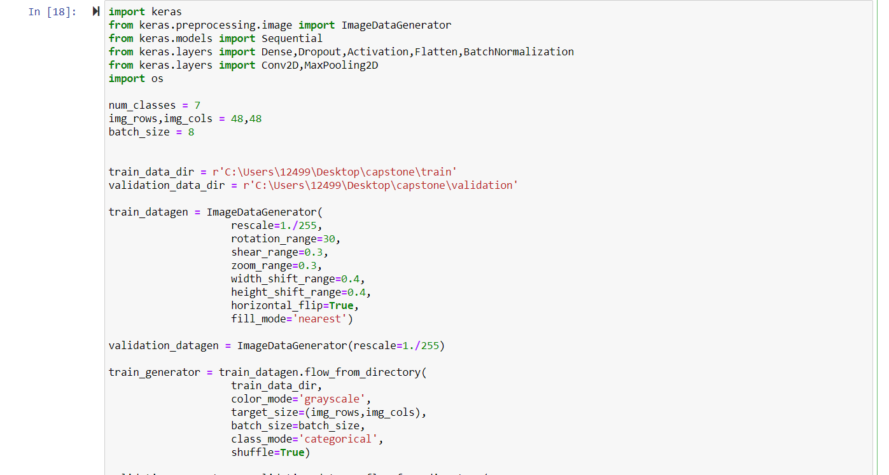
DATA CLEANING
The data in this format is already suitable to be used, so there is no need for any cleaning or reformatting

Slide 6
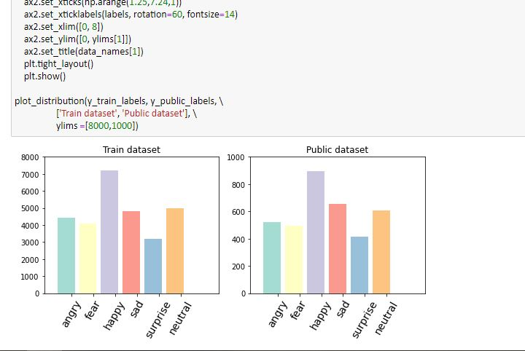
EXPLORATORY DATA ANALYSIS
Distribution of labels present in the dataset

Slide 7
ALGORITHM USED
CONVOLUTIONARY NEURAL NETWORK:
A Convolutional Neural Network (ConvNet/CNN) is a Deep Learning algorithm which can take in an input image, assign importance (learnable weights and biases) to various aspects/objects in the image and be able to differentiate one from the other.
The pre-processing required in a ConvNet is much lower as compared to other classification algorithms

Slide 8

ARCHITECTURE

Slide 9

CODE TO TRAIN OUR MODEL

Slide 10
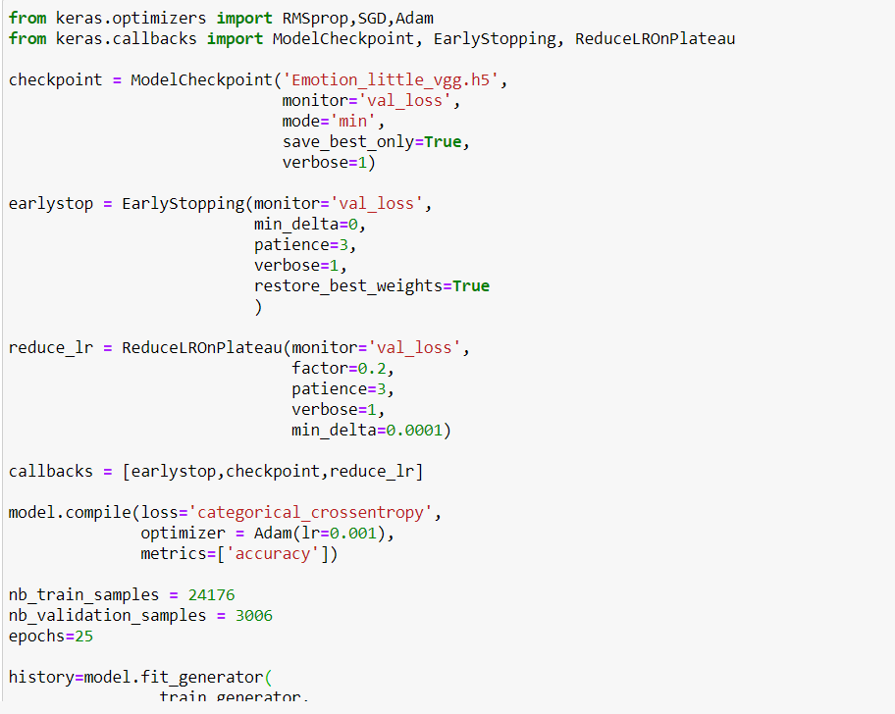
CODE TO OPTIMIZE

Slide 11
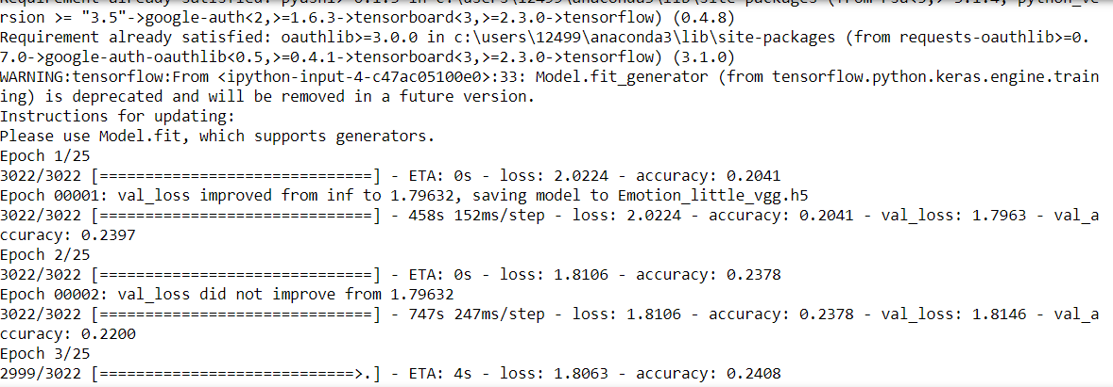
ACCURACY OF MODEL

Slide 12
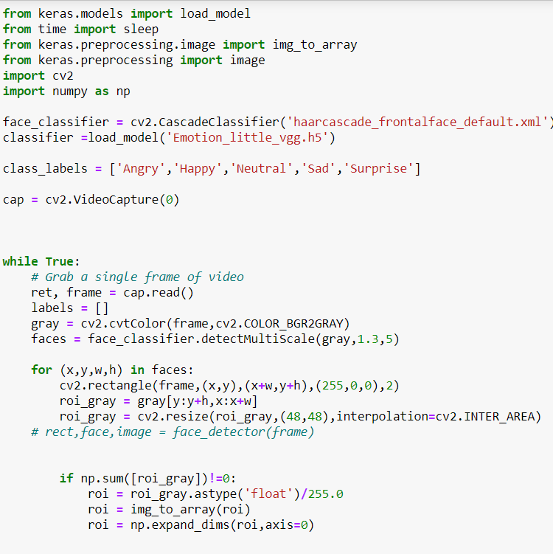
CODE TO CAPTURE IMAGE

Slide 13

OUTPUT IMAGES

Slide 14
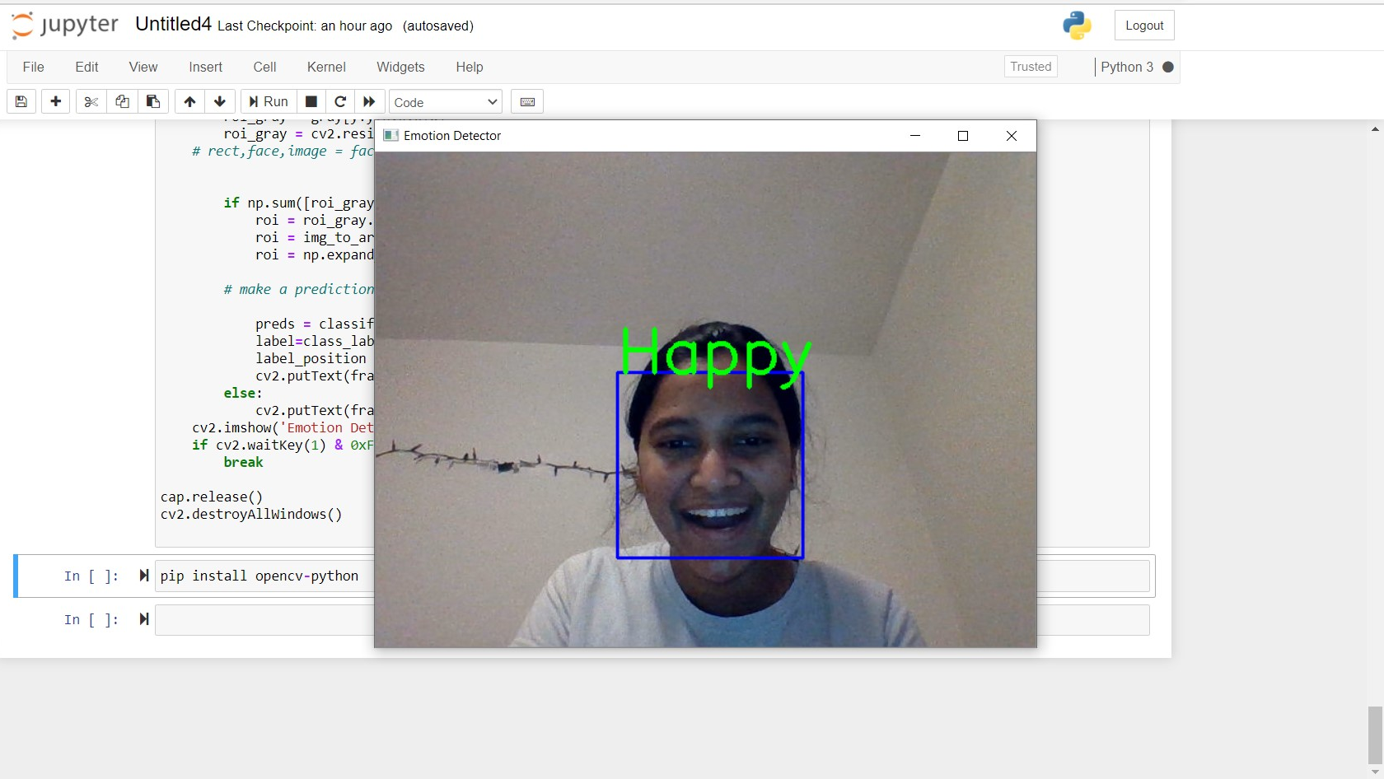
HAPPY

Slide 15
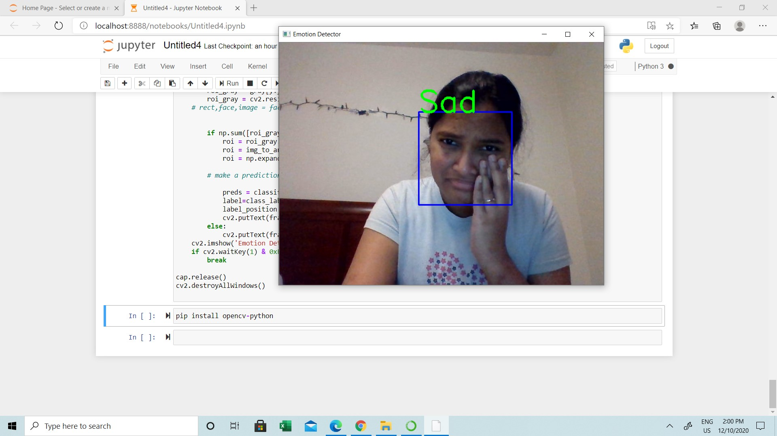
SAD

Slide 16
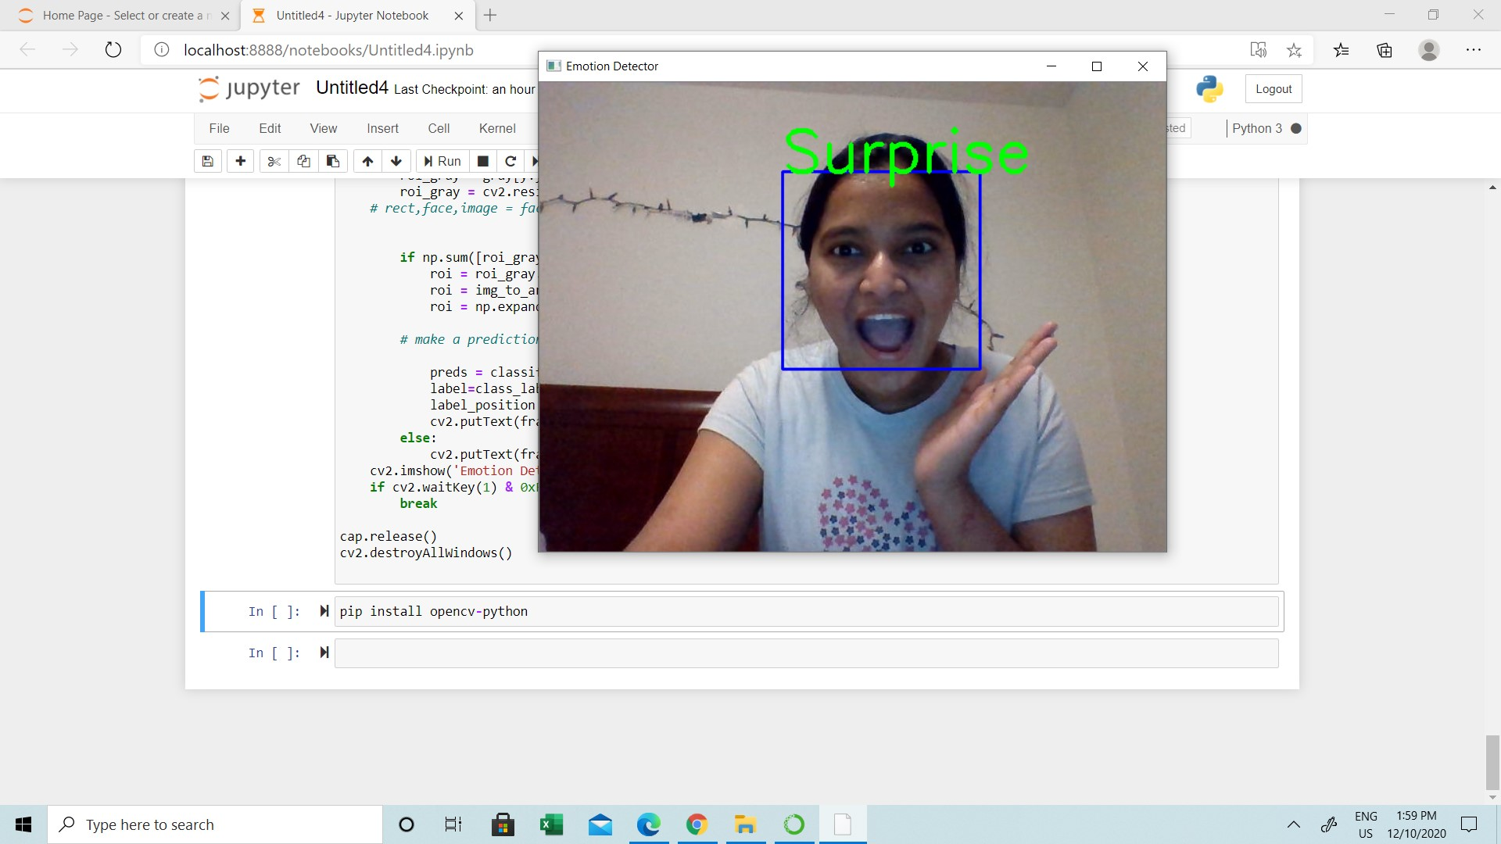
SURPRISE

Slide 17
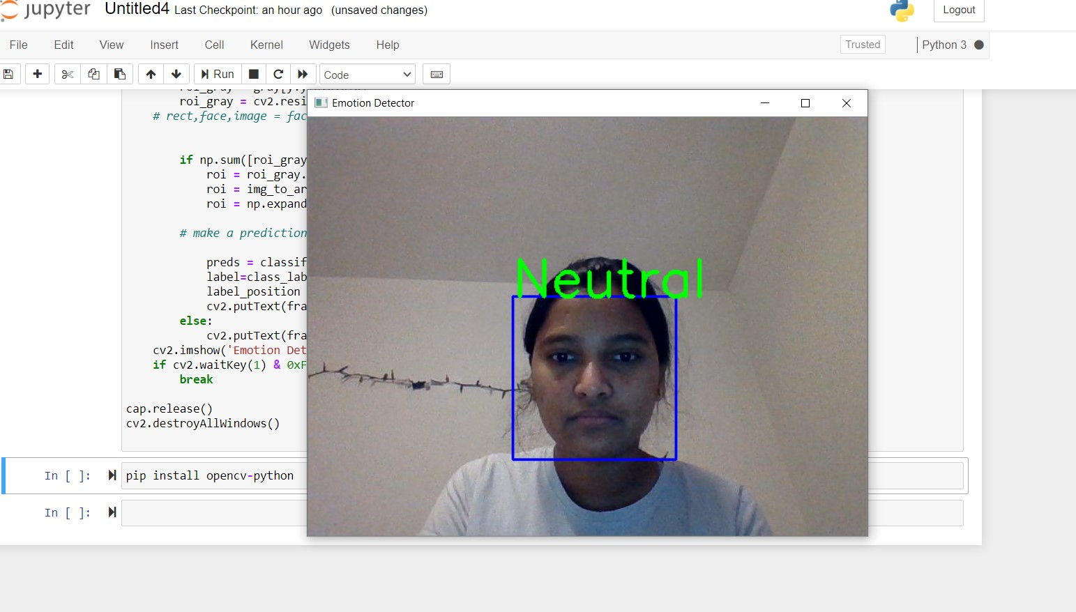
NEUTRAL

Slide 18
CONCLUSION
One of the most difficult part during the project was to deal with resources limitation regarding computational power, as TensorFlow no longer supports its models to run on GPU for MacOS and running the models on CPU was not a reliable option due timing and risk to damage hardware.
AWS could be a good option too, but thanks to the access to a good machine with TensorFlow GPU support to run the models, the researcher was able to train the classification models.

Slide 19
IMPROVEMENT
The main improvements that could be done for this project are:
• Train the algorithms with the entire data set of images. Due computational resource limitation, the model was train with a subset of images. Having an appropriate machine, the model can be trained including all the images. This will make the algorithm to learn from different context of the picture giving it more experience to predict better never seen images.
• Use difference structures for the CNNs. This approach could give better performance to the model, is an expensive task anyway, as the model can be measure on the test data set after is trained, and this takes time and computational resources.
• Environments where there is more than one subject in the picture was not part of the scope of this project, but it is a good improvement to develop a better application. OpenCV is a good candidate to help with this development, as it very accurate to detect feces and its position in the pictures, then that portion of the picture (the faces) can be classified separately using the developed models on this project.
• Integrate the solution with a user interface will be totally a plus for the development. To give more usability to the users, the solution can be integrated an API, and be consumed by Web and/or Mobile Applications.

Slide 20
REFERENCES
References:
[1] Yangsheng Wang Haitao Wang, Stan Z Li. Face recognition under varying lighting conditions using self-quotient image. Proceedings of the Sixth IEEE International Conference on Automatic Face and Gesture Recognition, 2004.
[2] Beat Fasel and Juergen Luettin. Automatic facial expression analysis: A survey. Pattern Recognition, 36(1), 1999.
[3] Xiaoyang Tan and B. Triggs. Enhanced local texture feature sets for face recognition under difficult lighting conditions. IEEE Transactions on Image Processing, 19(6).
[4] Michael Jones Paul Viola. Rapid object detection using a boosted cascade of simple features. Computer Vision and Pattern Recognition, 2001.
[5] Lijun Yin; Xiaozhou Wei; Yi Sun; Jun Wang; Matthew J. Rosato. A 3d facial expression database for facial behavior research. 7th International Conference on Automatic Face and Gesture Recognition, 2006.

